Slide 1
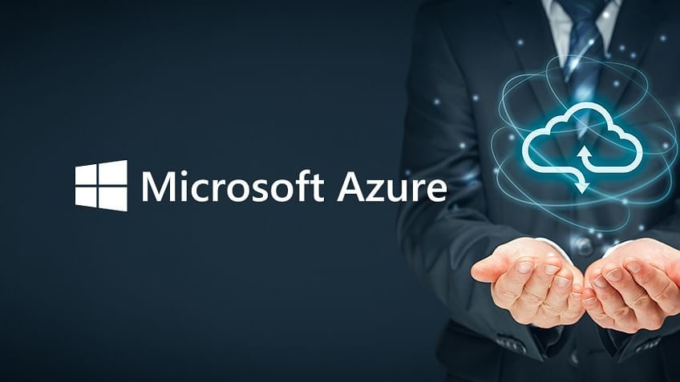
Cloud Computing
By. Kurt Jensen

Slide 2
Introduction
What I chose
Why I chose it
What I did
The components
How it works
Diagrams
Adherence to the 5 pillars
Pictures

Slide 3

What I chose
Azure Web App

Slide 4
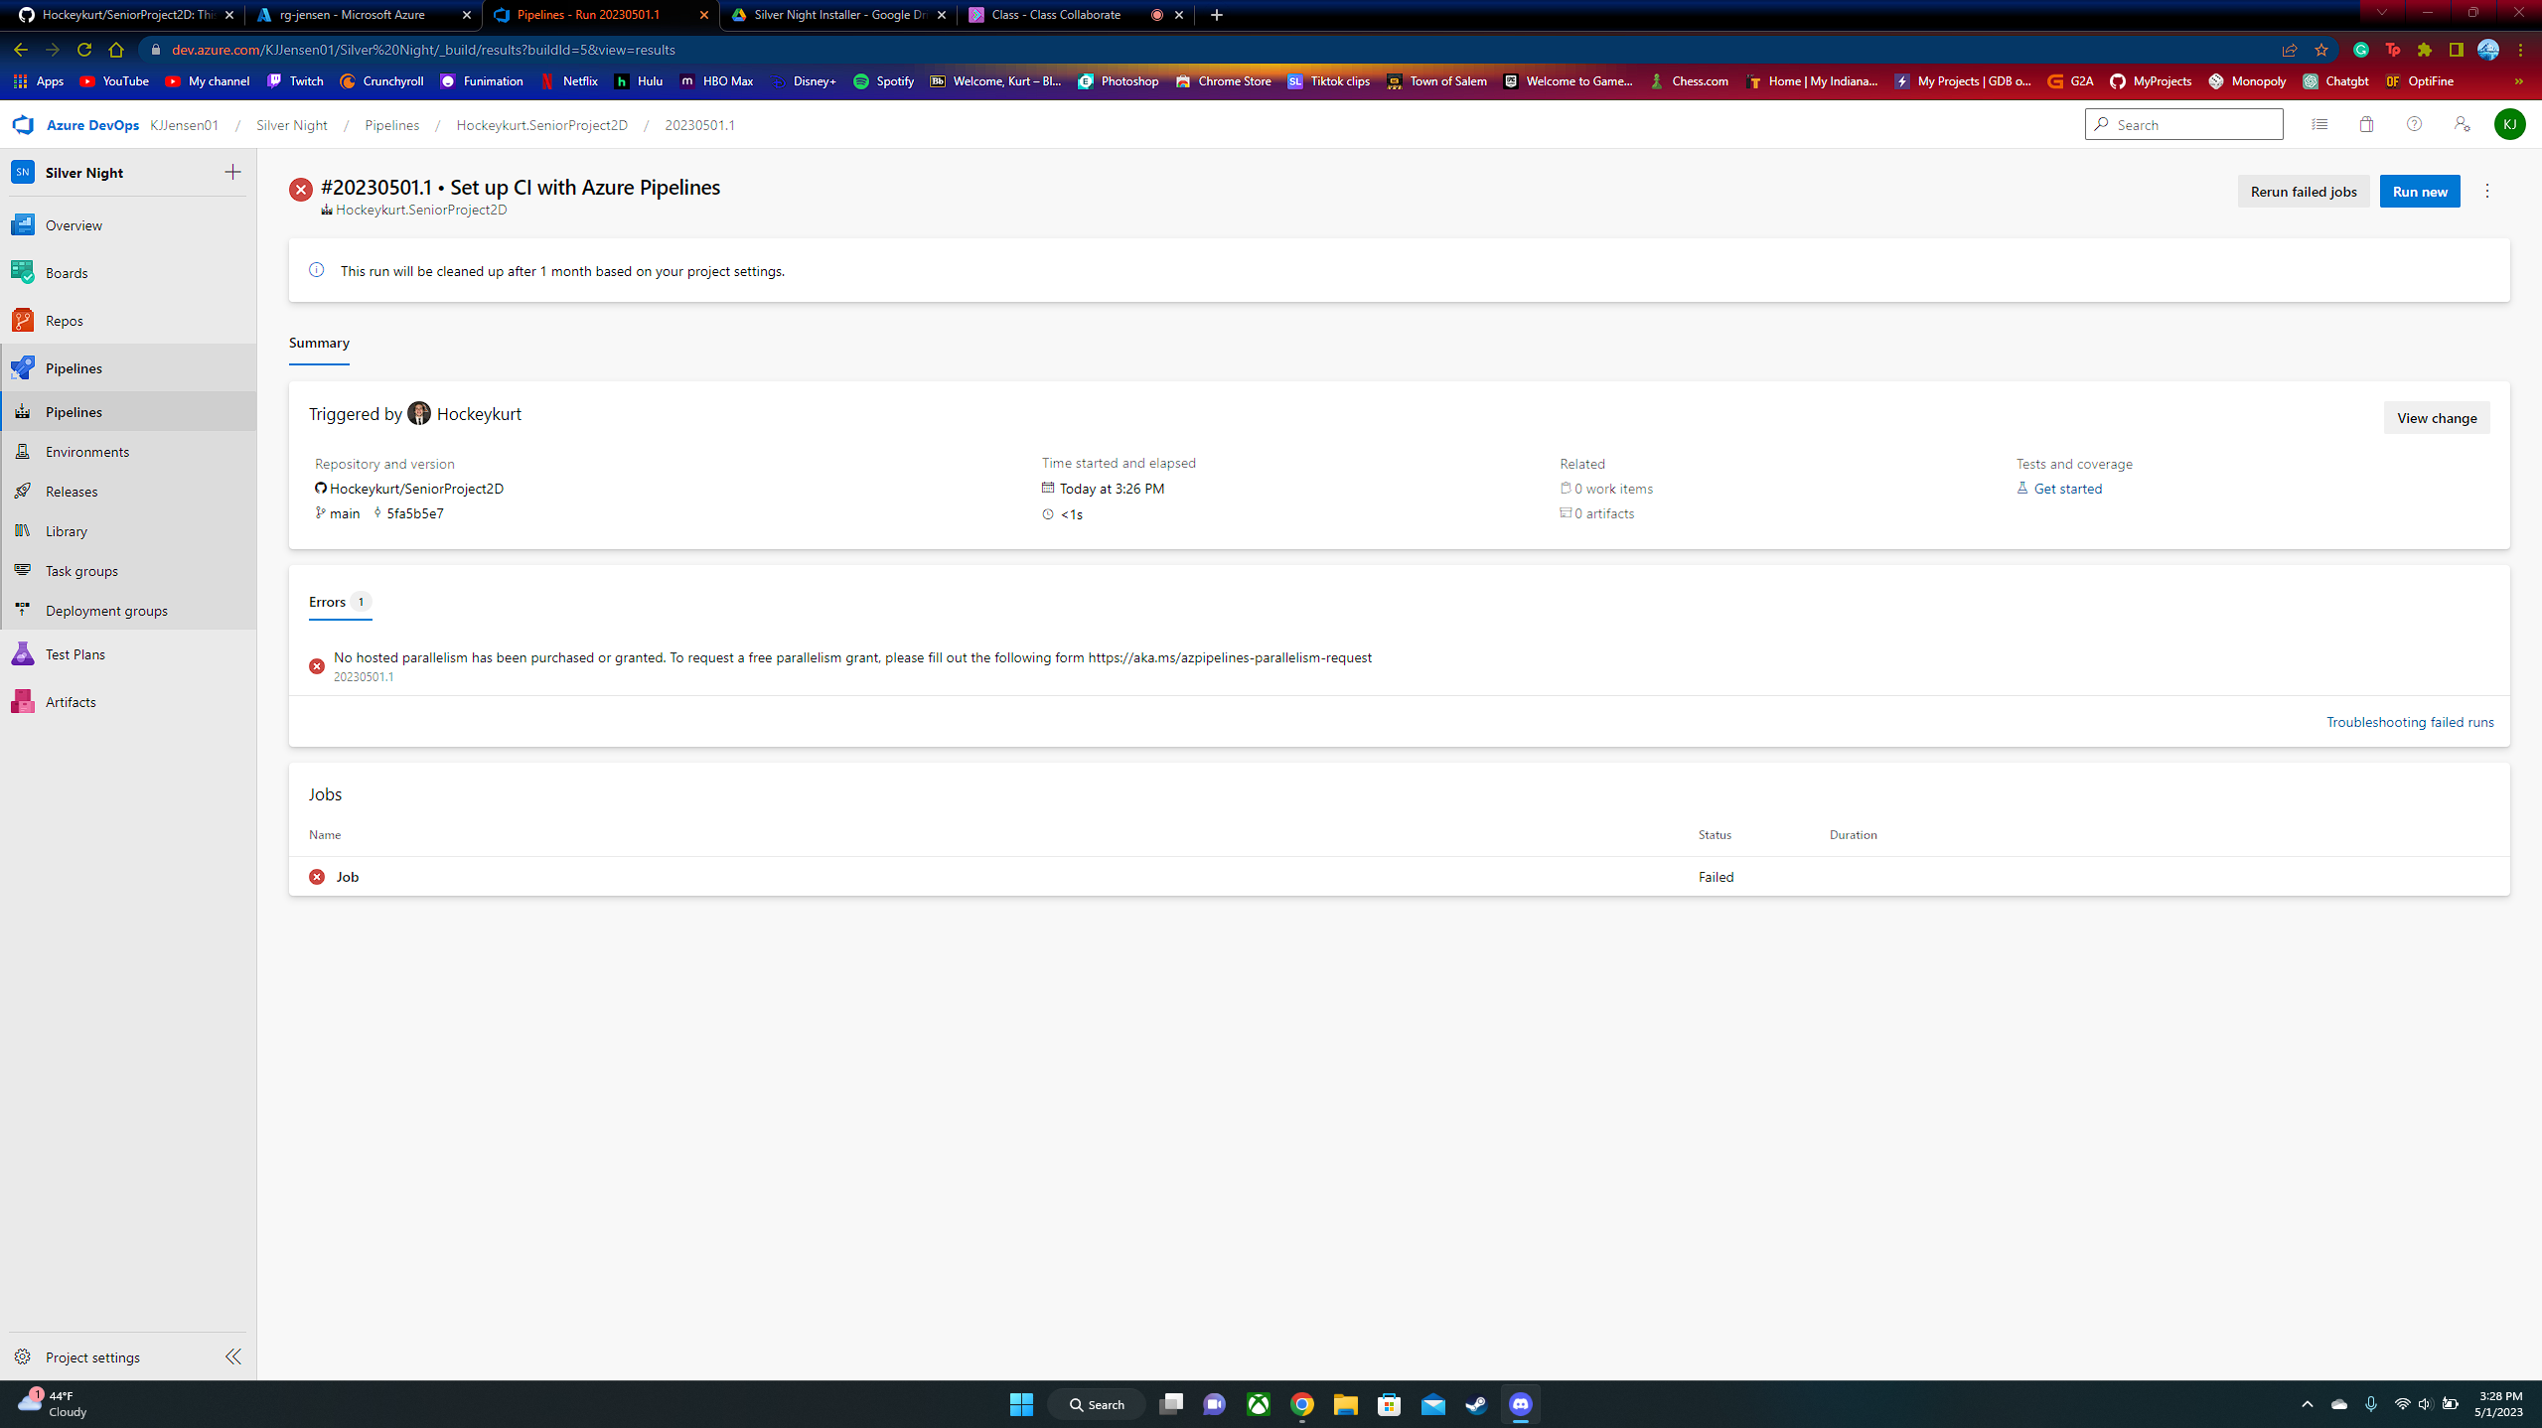
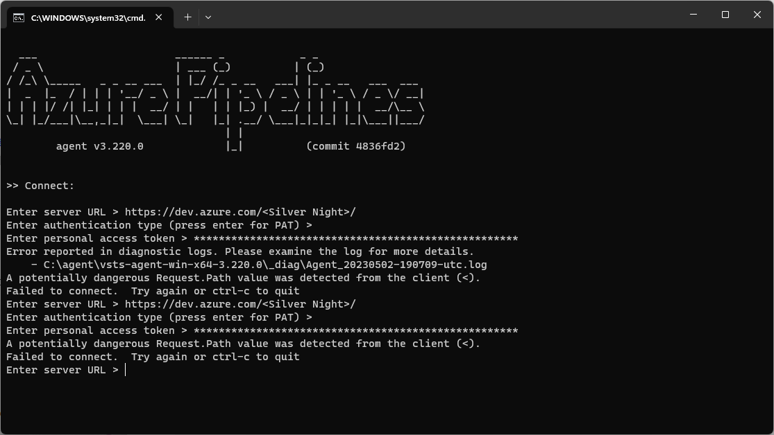
Why I chose it
Wanted to do something related to my senior project
Video game
At first, I was going to use Azure DevOps and GitHub to post every update I release for my game
I ran into many errors and problems
So, I switched to having Azure host my game publicly online for anyone to play.

Slide 5
What I did
Change my game to a WebGL game rather than an executable
Create a web.config file to be able to run my WebGL file onto the internet
Drag all my files into a visual studio web application template
Publish everything to the azure portal

Slide 6
The components
All the files included when building my game as a WebGL file
Web.config file
All the files included in the web app template on visual studio

Slide 7
How it works
Unity game engine builds your game to be able to run all your functions and game mechanics onto a web browser.
The web.config file lets you customize how your site looks and behaves
Visual studio web app template allows you to send everything to the azure portal and creates an azure web app running all the files you dump into it

Slide 8
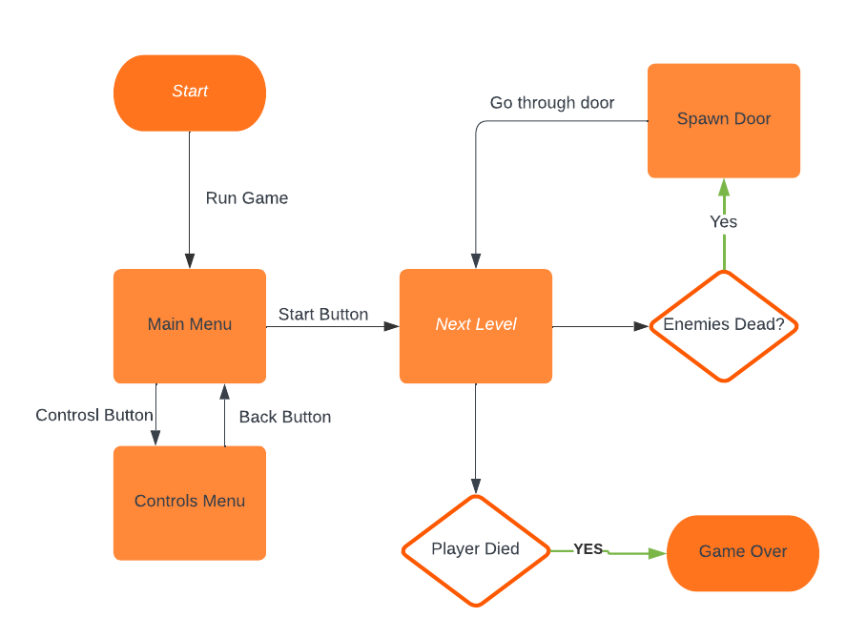
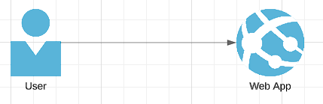
Diagrams

Slide 9
Adherence to the 5 pillars
Reliable
There is no information being stored when accessing the web app.
The cost to run the web app is free. I selected the free payment plan.
No new updates will occur after accessing the web app, so operations processes will keep running.
Performance will stay up as well.

Slide 10
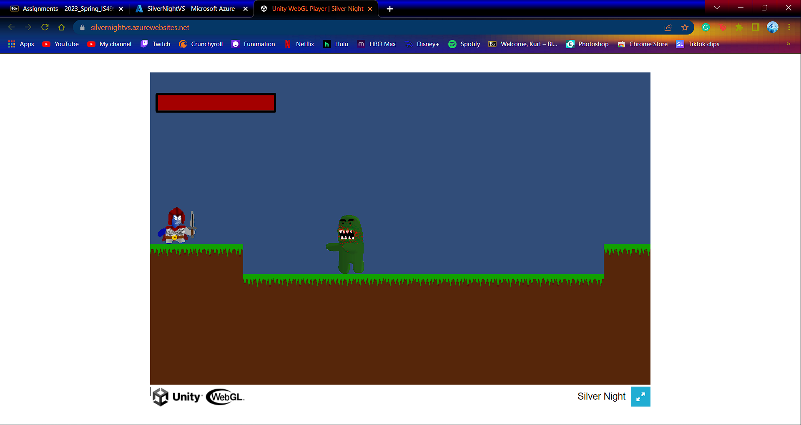
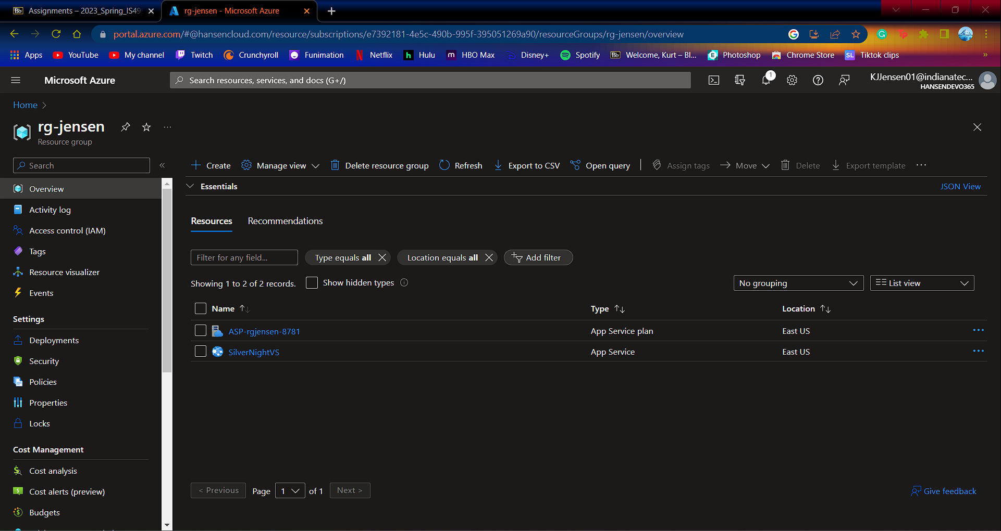
Pictures

